Slide 1
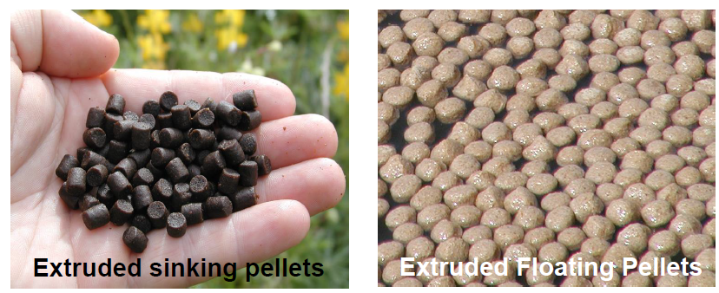

FISH MARKETING
Joseph Mphande
MSc Sustainable Aquaculture –University of Stirling, UK
MSc -Aquaculture and Fisheries Science-LUANAR, Malawi.
Email: josephmphande90@gmail.com

Slide 2
FISH MARKETING
Marketing is one of the main activities directly related to consumers that need to be carried out by the company
The main purpose of the marketing concept is to serve consumers by getting a number of profits

Slide 3
FISH MARKETING
Thus, marketers must provide customers with what they want to buy, with prices that represent the value of money.
Several processes are involved in the fish marketing system, it starts with transporting fish from farmers and finally received by consumers

Slide 4
FISH MARKETING
Preservation, transportation and marketing are three important links in the fish production and consumption chain
Harvesting and marketing of fish become profitable only when fishery products are sent in healthy conditions and at prices that are acceptable to consumers.
Notes:
that connect producers, intermediaries, wholesalers, retailers, and consumers

Slide 5
FISH MARKETING
Marketing Mix is a set of tools for tactical marketing that can be controlled, product, price, distribution, and promotion combined by the company to produce the desired response in the target market.

Slide 6
FISH MARKETING
Furthermore, the marketing mix can be used as a collection of variables that can be used by companies to influence consumer responses.
At first, the Marketing Mix included four Ps of marketing, namely Promotion, Product, Place, Price.
Then, other Ps were added as the additional factors to the formula namely Process, People and Physical Evidence.
This brought the total Ps to 7.

Slide 7
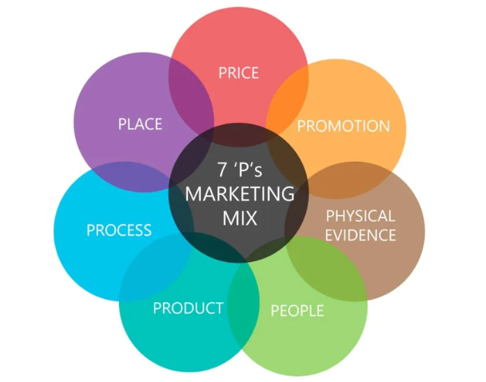
7Ps OF FISH MARKETING

Slide 8
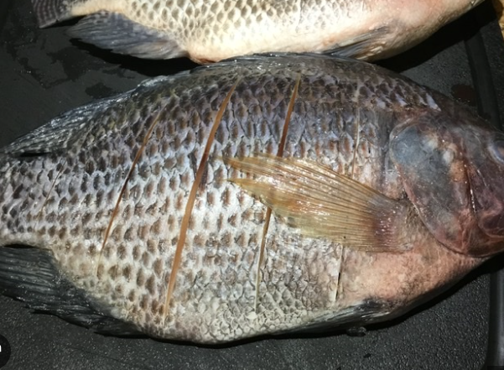
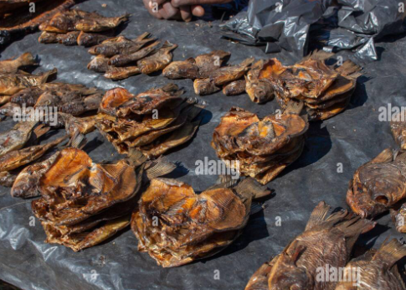
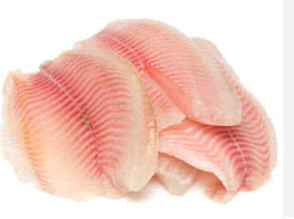
7Ps OF FISH MARKETING
1. Product.
The first “P” from Marketing Mix is Product, it can be the form of both goods or services from producer into the consumers.
The Product should fit the task consumers want it for, it should work and it should be what the consumers are expecting to get.

Slide 9
7Ps OF FISH MARKETING
1. Product.
When you’re marketing your product, you should think about the key features and benefits your customers want and how your product meets these needs.
Consider competitor products too how does the product you’re selling stack up against the competition in terms of product appearance, quality and durability?

Slide 10
7Ps OF FISH MARKETING
1. Product.
If you’re starting a new business, you should undertake a thorough customer and competitor analysis as part of the product development process.
Existing businesses can also benefit from performing a regular market analysis to help them ensure that their products continue to meet and exceed customer expectations.

Slide 11
7Ps OF FISH MARKETING
2. Promotion.
The way you promote your product will have a direct impact on the success of your brand.
Promotion is an effort to inform the consumers about the information about goods or services from marketers through several media or face to face.

Slide 12
7Ps OF FISH MARKETING
2. Promotion.
There are a vast number of promotional channels you can use in today’s market from traditional paid advertising via outdoor, TV, radio and the internet to more modern approaches including social media, SMS and email marketing email marketing.
Think about your target audience and the channels they use to be effective, you must promote your product where they are.

Slide 13
7Ps OF FISH MARKETING
2. Promotion.
If you’re not using digital promotion to market your business in 2024, you’re missing out on a huge opportunity.
E-advertising has brought great opportunities for marketers to attract the interest of consumer negating their gender, age or community through the Internet and web-based marketing.

Slide 14
7Ps OF FISH MARKETING
3. Place
The product should be available from where your target consumer finds it easiest to shop.
This may be in shops, Malls or the more current option via e-commerce or an online shop.

Slide 15
7Ps OF FISH MARKETING
3. Place
The place of the sale by using IT is a site or a market place in the social network and the Internet.
Customers can quickly get information about the products or services and comparing similar products without visiting the market place of the house of auction.

Slide 16
7Ps OF FISH MARKETING
4. Process
Process, it is the whole actual procedure, mechanism, and activity flows that used regarding to the goods and services delivered to customers satisfied.
Process refers to the processes involved in delivering your product or service to customers.

Slide 17
7Ps OF FISH MARKETING
4. Process
This includes aspects like your sales your payment systems, your distribution approach and the way you manage customer relationships.
Having established, customer-focused processes in place supports your people to deliver a positive and consistent customer experience and work more efficiently.

Slide 18
7Ps OF FISH MARKETING
4. Process
Supply Chain is an effort to increase the marketer's competitive value to be more efficiency, which is managing the flow of the process from raw material suppliers through factories and warehouses to the end customer.

Slide 19
7Ps OF FISH MARKETING
5. Price
The Product should always be seen as representing good value for money.
This does not necessarily mean it should be the cheapest available; one of the main tenets of the marketing concept is that customers are usually happy to pay a little more for something that works really well for them.

Slide 20
7Ps OF FISH MARKETING
5. Price
Pricing in marketing should follow the market dynamics, also it is formed according to the rules of classical price formation, namely: cost, customer value, and competitors.

Slide 21
7Ps OF FISH MARKETING
6. People
All companies are reliant on the people who run them from front line Sales staff to the Managing Director.
Having the right people is essential because they are as much a part of your business offering as the products/services you are offering.
People in marketing involving the consumers and all the workers.

Slide 22
7Ps OF FISH MARKETING
7. Physical evidence
Physical Evidence, such as building and environmental surrounding, equipment, logo, instrument, color, packaging are important.
Almost all services include some physical elements even if the bulk of what the consumer is paying for is minimal.

Slide 23
7Ps OF FISH MARKETING
7. Physical evidence
Physical evidence isn’t just the marketing-focused things your customers see it also includes operational aspects like the way your staff look and act, your receipts or invoices.

Slide 24
CHALLENGES FACING EMERGING AQUACULTURE ENTREPRENEURS
Lack of availability of necessary resources such as land, water, infrastructure
Lack of financial support (Several financial institutions view aquaculture as a high-risk business, and as a consequence, decline financial support or loan requests from emerging farmers)
Lack of access to markets

Slide 25
CHALLENGES FACING EMERGING AQUACULTURE ENTREPRENEURS
High Crime rates in some countries
Limited human resources in capacity building, skills and aquaculture expertise
Complex legislation governing aquaculture further limits the development of this sector to prospective investors
Fish and machinery theft in fish farms has an adverse effect, which had resulted in many enterprises closing down

Slide 26
Possible solutions
What are some of the solutions to the above challenges?

